Slide 1



PROBLEM STATEMENT
“Eco World” – Environmental
Awareness Website
TEAM NAME: STRATEGISTS
25EC132 PRIYA.K
25EC154 SNEHALATHA.N
25EC138 RISHVANAPARVEEN.S
25EC156 SOWBARANI.S
U23CS381 – Application Design and Development

Slide 2
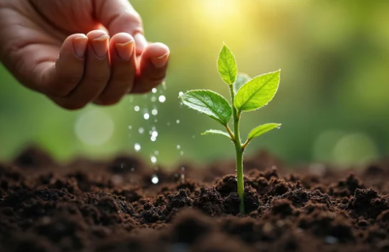
Website Workflow / User Flow
Work flow of Eco World Website
User visits homepage → sees awareness video & info graphics.
User scrolls → finds pledge form.
User enters Name + Eco Action → submits.
JavaScript stores pledge in array.
DOM updates → pledge list displayed on page.
Multiple users → community pledge list grows.
U23CS381 – Application Design and Development

Slide 3
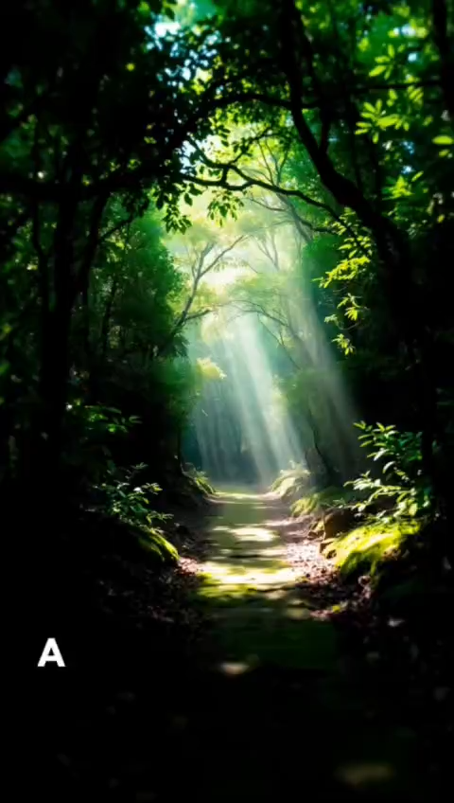
Page Layout & Structure
Header:
Title “Eco World – Go Green!”
Section 1:
Embedded awareness video.
Section 2:
Info graphic images (Save Trees, Reduce Plastic).
Section 3:
Pledge Form (Name + Action + Submit).
Section 4:
Display pledges dynamically using JavaScript.
U23CS381 – Application Design and Development

Slide 4
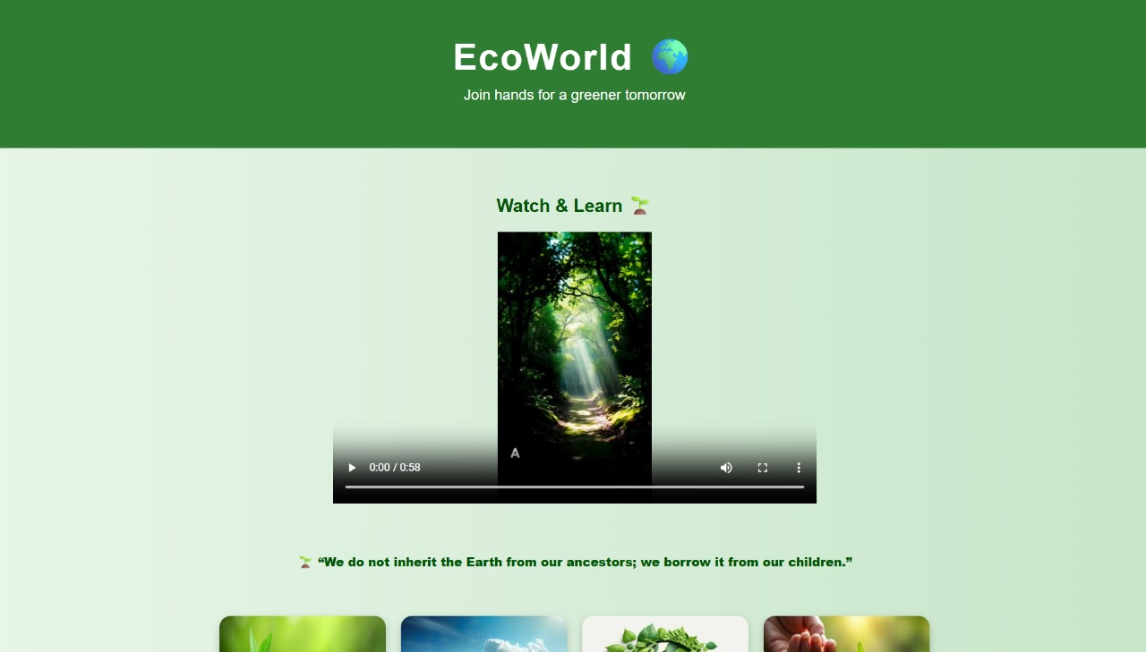
Screenshots
U23CS381 – Application Design and Development

Slide 5
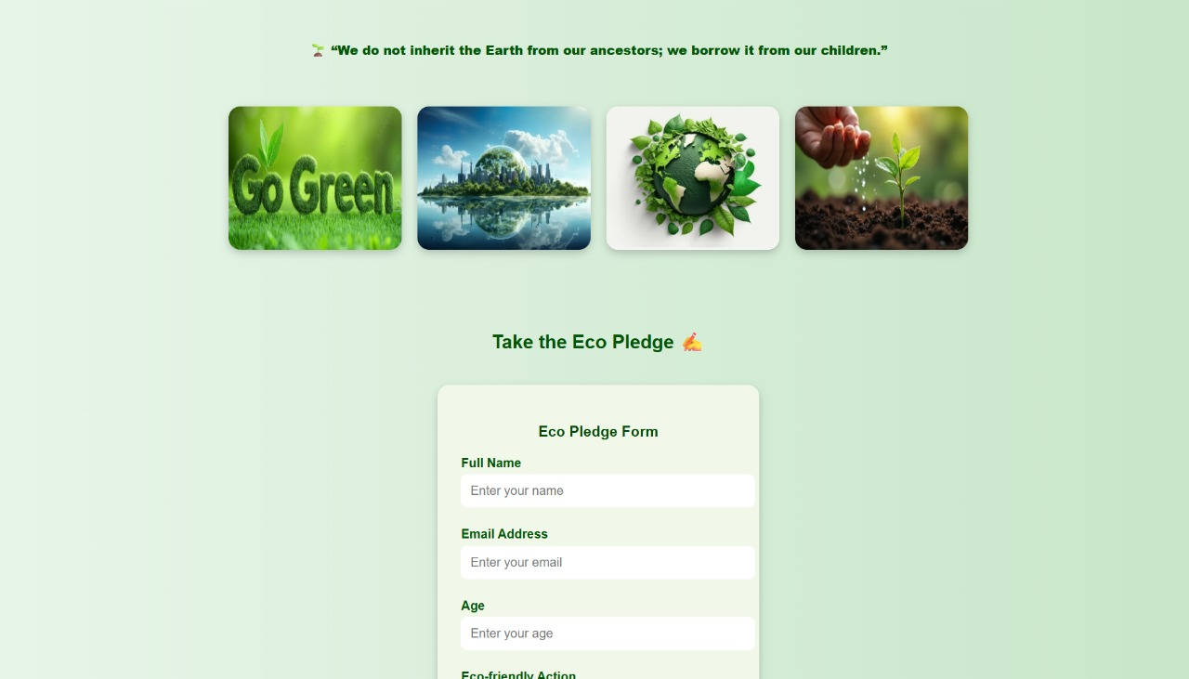

Slide 6
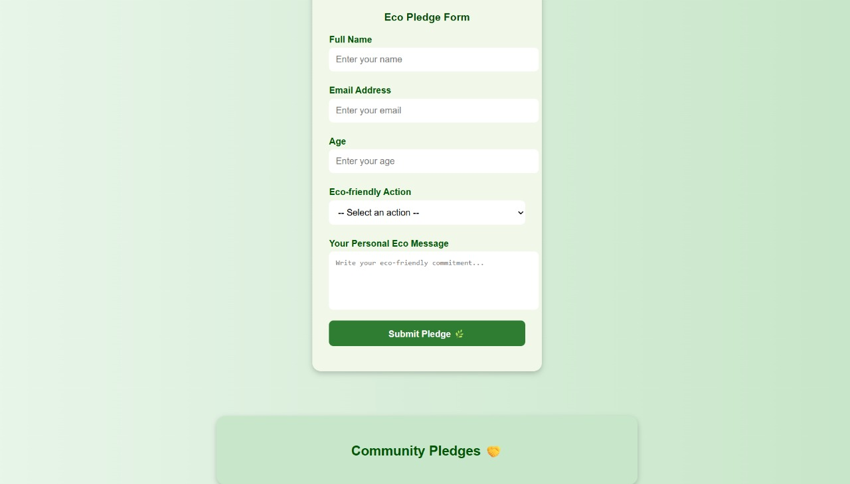

Slide 7
THANK YOU🌿

